Slide 1
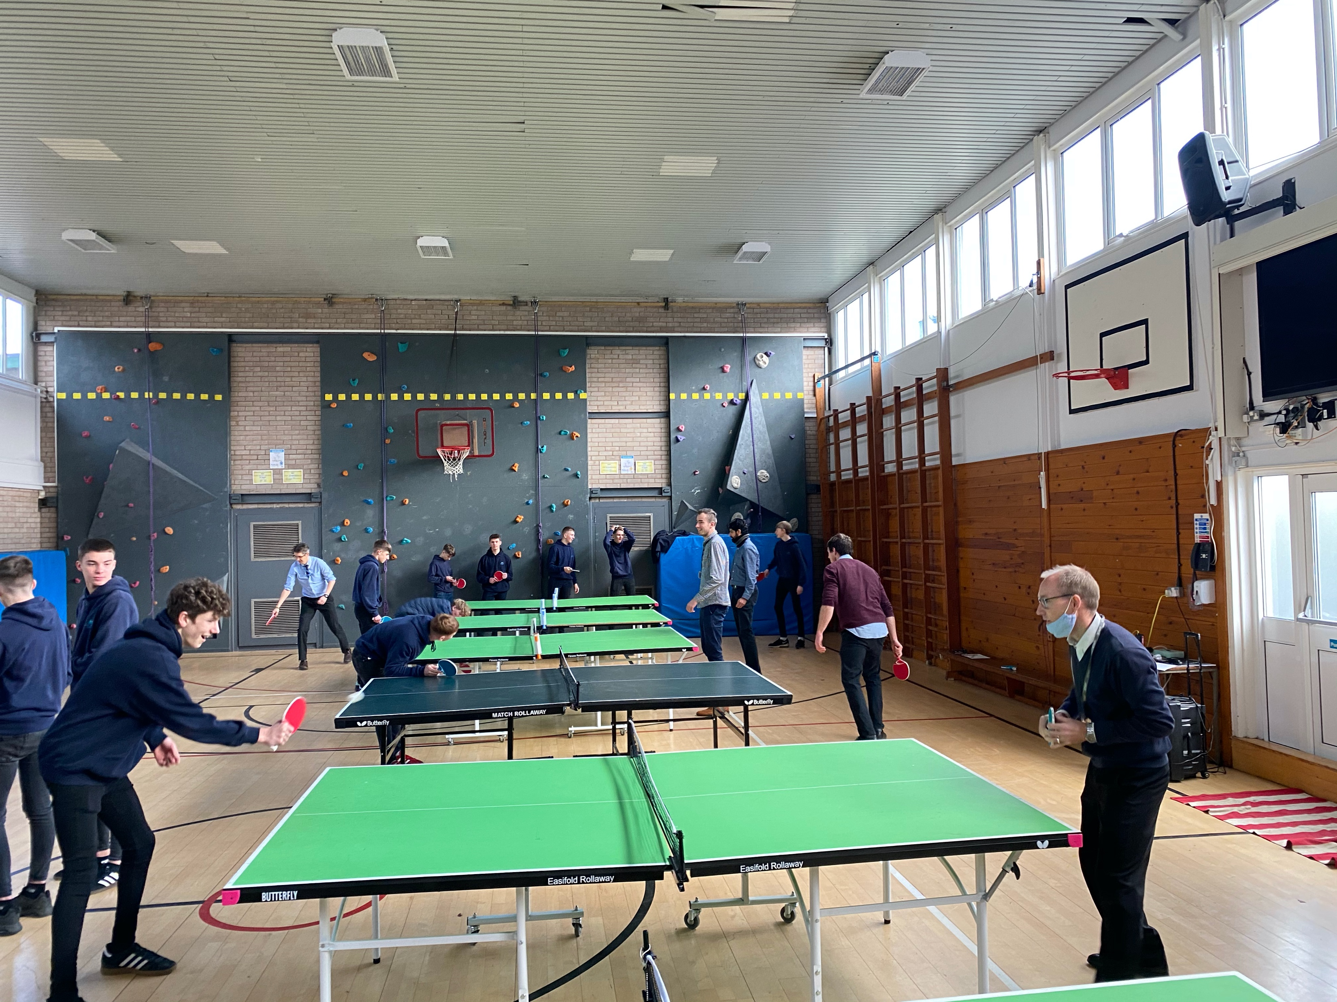
P.E.
Miss Angela Astbury
Information for students
GCSE Options Process

Slide 2
What will I learn?
Practical Element |  | Students undertake three physical activities from a set list from OFQUAL, each activity is worth 10% One team, One individual & One free choice | 30%
Course Work |  | Students undertake a personal exercise plan in one of the sports they are offering for their practical element. | 10%
Theory Element | Exam Paper One: 1hr 45 | Fitness & Body Systems Topic 1. Applied anatomy and physiology Topic 2. Movement analysis Topic 3. Physical Training Topic 4. Use of data | 36%
 | Exam Paper Two: 1hr 15 | Health and Performance: Topic 1. Health, fitness and well-being Topic 2. Sport psychology Topic 3. Scio-cultural influences Topic 4. Use of data | 24%
www.hopevalley-chorustrust.org/GCSEoptions

Slide 3
How will I be assessed?
Theory (60%) Exam papers |  | Practical | Course Work
Paper One: 1hr 45 exam | Paper Two: 1hr 15 exam | 30% | 10%
36% | 24% | 30% | 10%
Fitness & Body Systems | Health and Performance | Assessment consists of students completing three physical activities from a set list (one team, one individual & one choice) Students will be assessed against set assessment criteria found in the Pearson Edexcel GCSE (9-1) guide | Assessment consists of students producing a personal exercise plan (PEP) and will require students to analyse and evaluate their performance.
Assessment consists of multiple choice, short answers and extended writing questions.
www.hopevalley-chorustrust.org/GCSEoptions

Slide 4
What skills do I need? OFQUAL list of Individual Activities
List of approved OFQUAL Individual Activity |  |  | Must be a competitive element ( not just recreational)
Amateur boxing |  |  | Rock climbing | Can be indoor or outdoor
Athletics |  |  | Rowing | Cannot be assessed with canoeing, kayaking or sculling
Badminton | Cannot be assessed with doubles |  | Sculling | Cannot be assessed with rowing. canoeing or kayaking
Canoeing |  |  | Skiing | Outdoor/indoor on snow: cannot be assessed with snowboarding. Must not be dry slopes
Dance | This can only be used for one activity |  | Snowboarding
Cycling | Track or road cycling only |  | Squash | Cannot be assessed with doubles
Diving | Platform diving |  | Swimming | Not synchronised swimming
Golf |  |  | Table tennis | Cannot be assessed with doubles
Gymnastics | Floor routines and apparatus only |  | Tennis | Cannot be assessed with doubles
Equestrian |  |  | Trampolining
Kayaking | Cannot be assessed with canoeing, rowing or sculling |  | 21 | Any of the above can be offered IF they are being undertaken at competitive club level
xxxx
www.hopevalley-chorustrust.org/GCSEoptions

Slide 5
What skills do I need? OFQUAL List of TEAM Activities
List of approved OFQUAL TEAM Activity |  |  | Must be a competitive element ( not just recreational)
Association football | Cannot be five-a-side or futsal |  | Lacrosse | ‘
Badminton | Cannot be assessed with singles |  | Netball
Basketball |  |  | Rowing | Cannot be assessed with sculling, canoeing or kayaking. This can only be used for one activity
Camogie | Cannot be assessed with hurling |  | Rugby league | Cannot be assessed with rugby union or rugby sevens — cannot be tag rugby
Cricket |  |  | Rugby union | Can be assessed as 7s or 15s. Cannot be assessed with rugby league, cannot be tag rugby. This can only be only be used for 1 activity
Dance | This can only be used for one activity |  | Squash | Cannot be assessed with singles
Gaelic football |  |  | Table tennis | Cannot be assessed with singles
Handball |  |  | Tennis | Cannot be assessed with singles
Hockey | Must be field hockey, not ice or roller hockey |  | Volleyball
Hurling | Cannot be assessed with camogie |  | 19 | Any of the above can be offered IF they are being undertaken at competitive club level
www.hopevalley-chorustrust.org/GCSEoptions

Slide 6
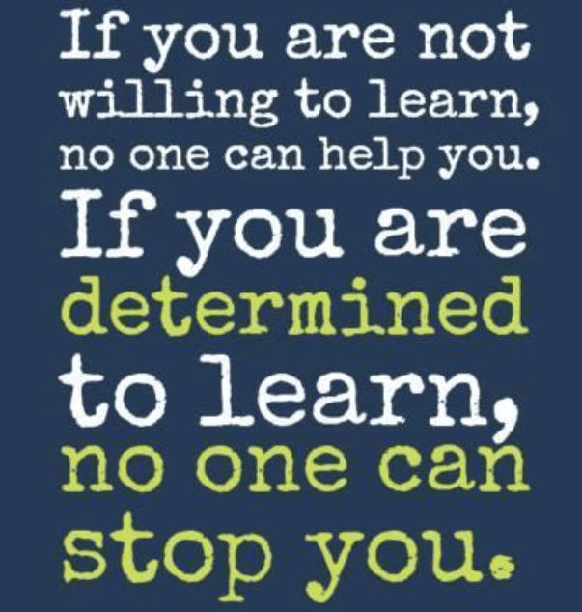
What skills do I need?
Practical skills (30%) | Theory skills (60% + 10%) | Character & Values
Ideally, you have represented the school or a club at sport You will need to enjoy sport and show willingness to learn new sports / invest your time in getting better at sport | A willingness to engage fully in the theoretical written content. A willingness to engage in learning how to write better essays
www.hopevalley-chorustrust.org/GCSEoptions

Slide 7
Who can answer my questions?
Miss A Astbury or Mr A Jenkinson
FAQ:
Will there be lots of practical lessons?
60-70% of the lessons will be in the classroom covering the theoretical content, rather than the sports hall/ field/ court. This reflects the requirements of the course assessments
Can I offer any sports from the OFQUAL list?
Sports on the OFQUAL list can be offered if they are being undertaken in a competitive club setting. For example, swimming can be offered if you are competing at club level and attend galas, but if done purely recreationally without a competitive element then this can not be offered.
Will I get to try a number of different sports at HVC?
We will offer sports that our environment, resources and expertise allow for, regrettably this means a number of sports are not viable (eg, diving, canoeing, trampolining & camogie/hurling). We can guarantee that we will undertake football, netball, table tennis and athletics
www.hopevalley-chorustrust.org/GCSEoptions

