Slide 1
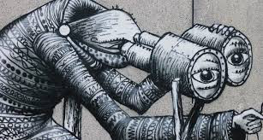
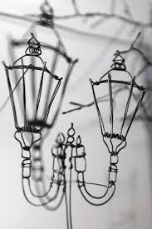
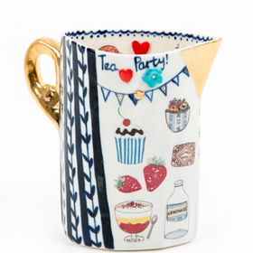
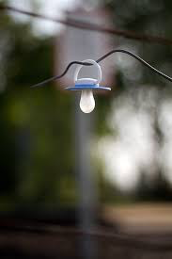
3D Artwork
Create a range of 3D pieces inspired by the following artists. For each artist remember all 4 of the assessment criteria:
AO1: RESEARCH
AO3: DRAW & LABEL
AO4: FINAL PIECE
AO2: EXPERIMENT
Create a:
3D Art Title page
PHLEGM | TO DO: | DOT | Comments
 | Artist Fact Page
 | Mark making
 | Drawings from Phlegm's work
 | Drawing of sculpture with labels
 | Final piece & evaluation
HELAINA SHARPLEY | TO DO: | DOT | Comments
 | Artist Fact Page
 | 30 second drawings
 | Wire experiments
 | Drawing of final piece with labels
 | Final piece & evaluation
KATIE ALMONDS | TO DO: | DOT | Comments
 | Artist Fact Page
 | Patterns page
 | Tile experiments
 | Drawing of final piece with labels
 | Workshop photos & write up
 | Final piece & evaluation
LIAM FRANKLANDS | EXTRA (OPTIONAL) CHALLENGE:
 | Artist Fact Page
 | Moodboard and analysis
 | Plan for final piece with drawing & labels
 | Final piece & evaluation

Slide 2
OTHER ARTIST YOU COULD LOOK AT:
3D Artwork
Jennifer collier – 3d map items
Andy Goldsworthy – Found creations
Emma Wilson – Clay spoons
Caroline Chouler Tissier

