Slide 1
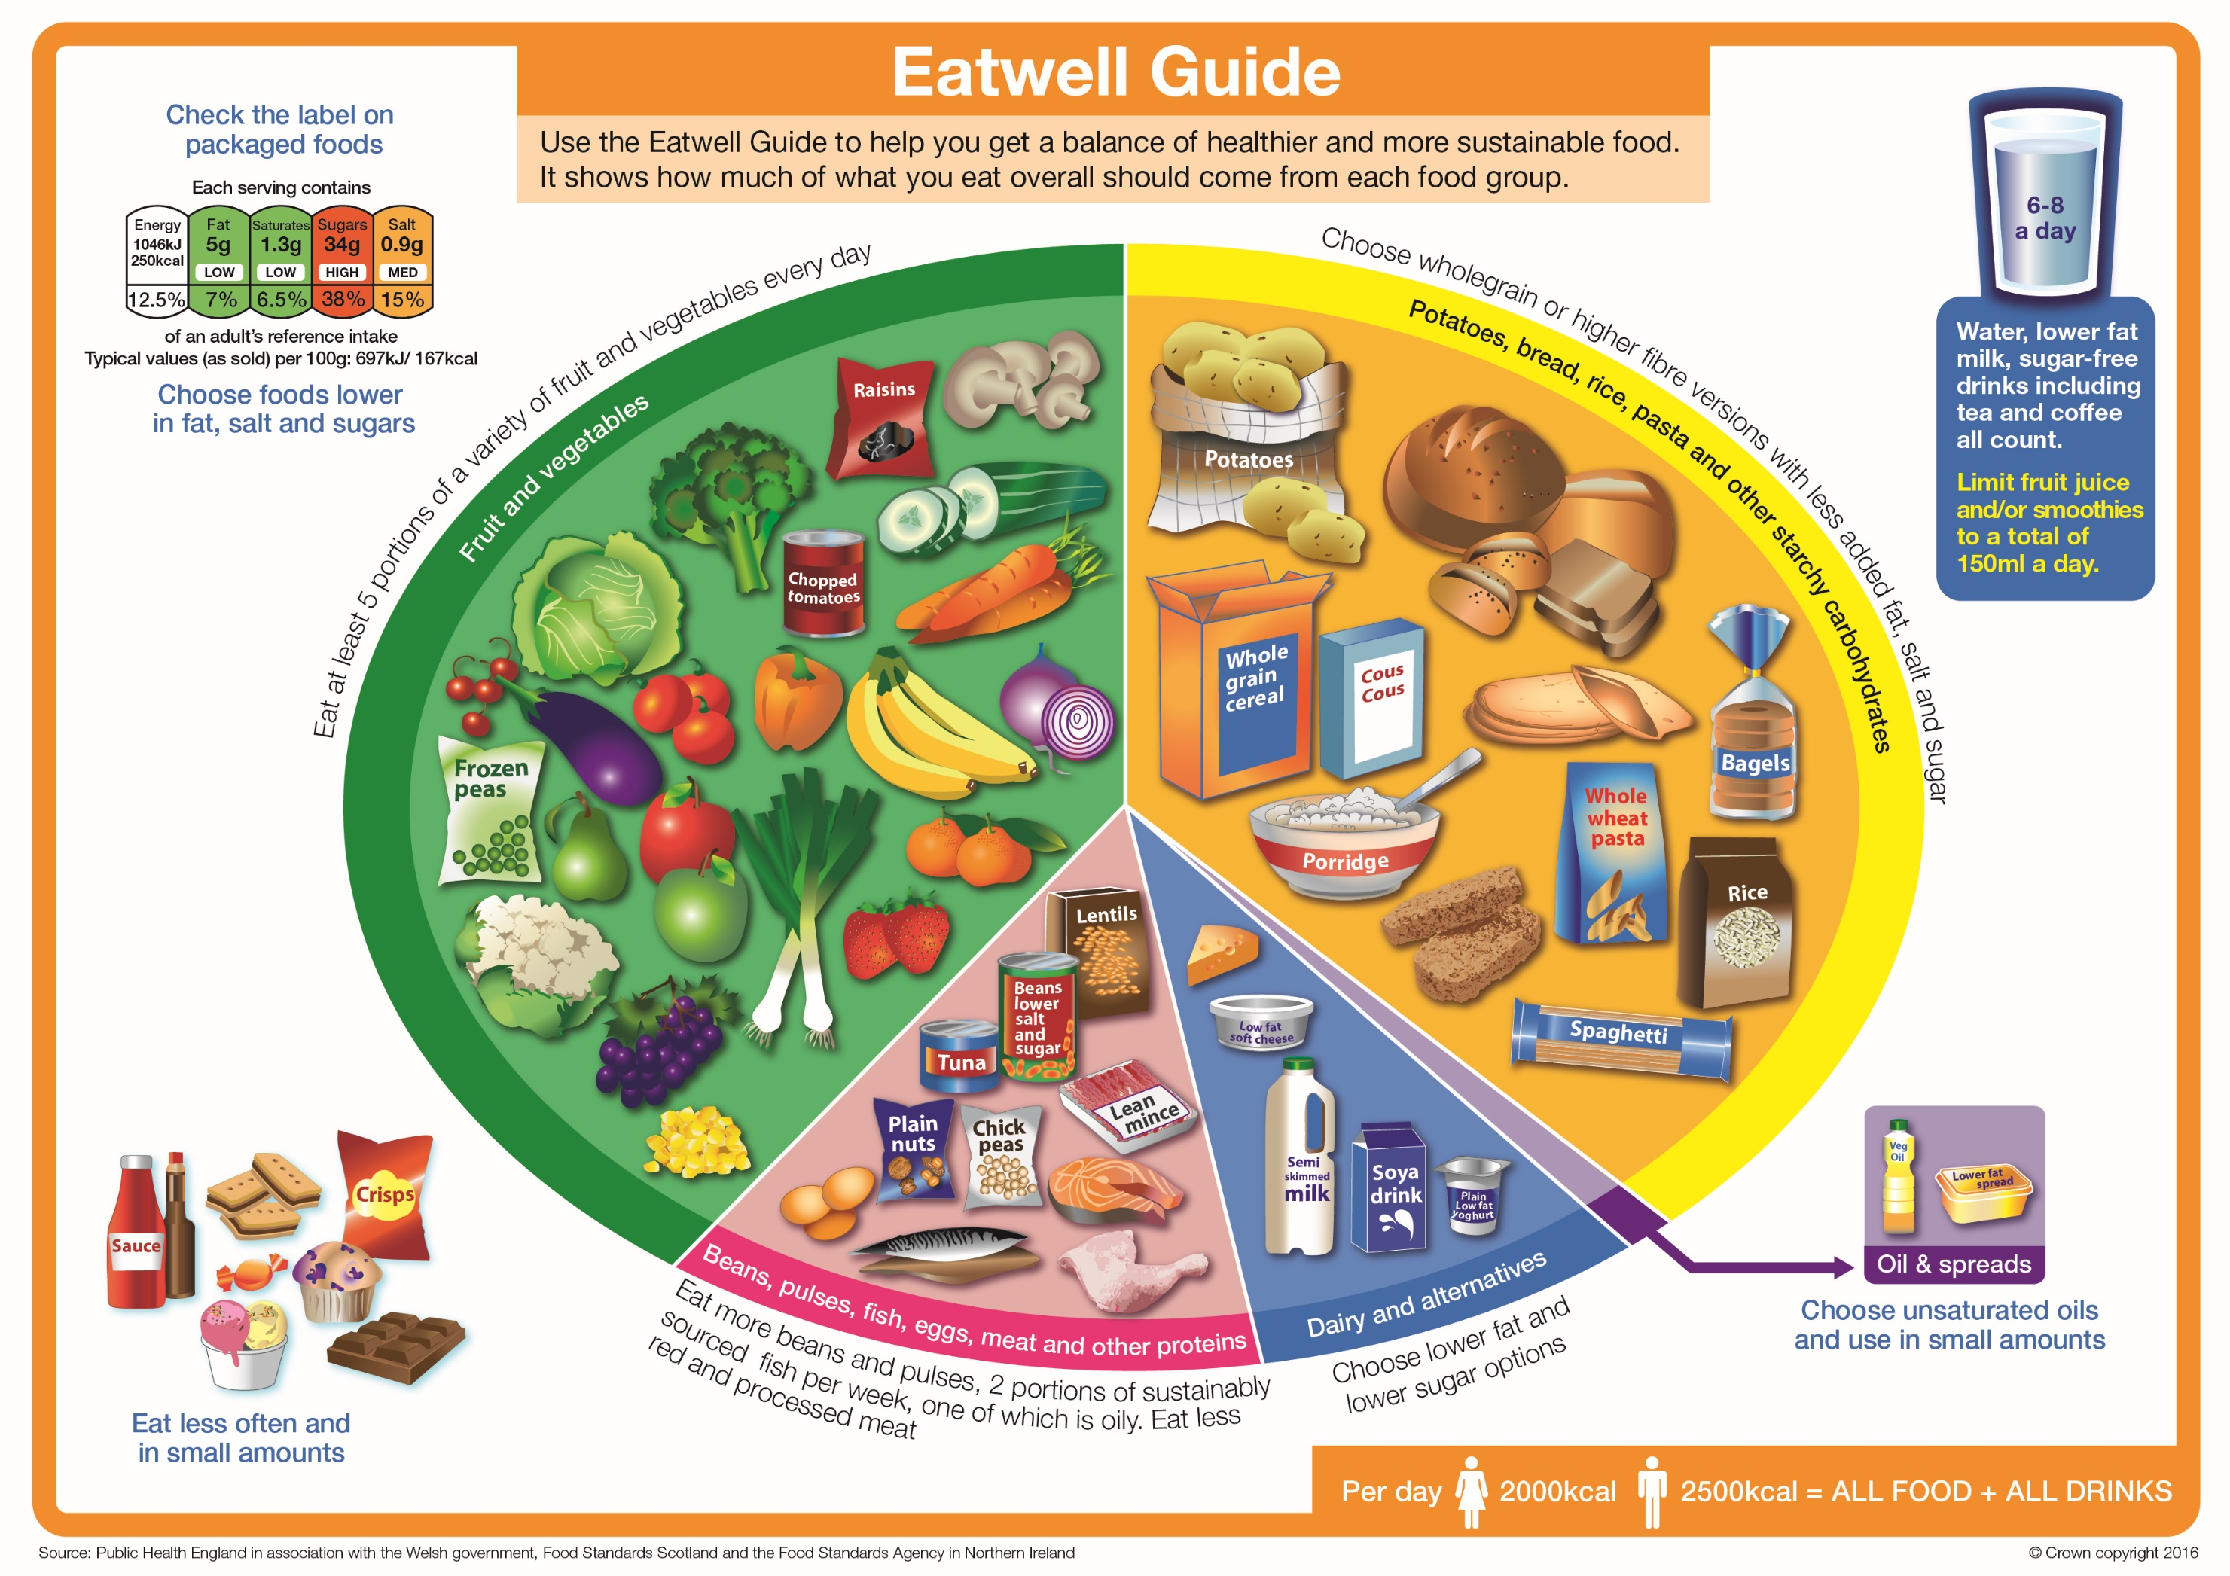
AC1.1 Nutrition
What is a Macro Nutrient?
What is a Micro Nutrient?
Describe functions of nutrients in the human body.
Carbohydrate: Starch What is the RDI?
Function:
Food sources:
Carbohydrate: Sugar What is the RDI?
Function:
Food sources:
Summarise The Eatwell Guide (include percentages using Internet research):
Protein: High Biological Value (HBV)
What is the RDI?
Function:
Number of amino acids:
Food sources:
Protein: Low Biological Value (LBV)
What is the RDI?
Function:
Number of amino acids:
Food sources:
Fat: Saturated
What is the RDI?
Function:
Food sources:
Medical conditions caused by consuming too much saturated fat:
Fat: Unsaturated
What is the RDI?
Function:
Food sources:
Benefits of consuming some unsaturated fat:

Slide 2
AC1.1 Nutrition
Vitamin A (Fat Soluble):
What is the RDI?
Function:
Food Sources:
Vitamin D (Fat Soluble):
What is the RDI?
Function:
Food Sources:
Describe functions of nutrients in the human body.
Iron:
What is the RDI?
Function:
Food sources:
Deficiency:
Vitamin E (Fat Soluble):
What is the RDI?
Function:
Food Sources:
Vitamin K (Fat Soluble):
What is the RDI? Function:
Food Sources:
Calcium:
What is the RDI?
Function:
Food sources:
Deficiency:
Vitamin B Group (Water Soluble): What is the RDI?
Function:
Food Sources:
Vitamin C (Water Soluble): What is the RDI?
Function:
Food Sources:
Sodium:
What is the RDI?
Function:
Food sources:
Deficiency:
Water What is the RDI?
Function:
Food sources:
Fibre What is the RDI?
Function:
Food sources:

