Slide 1
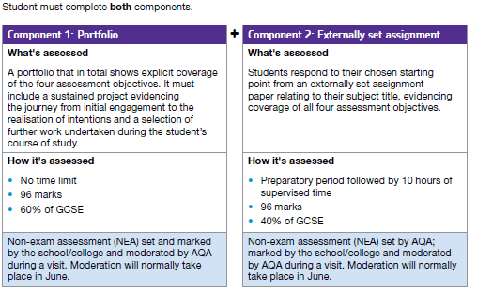
Textiles Technology
GCSE OVERVIEW

Slide 2
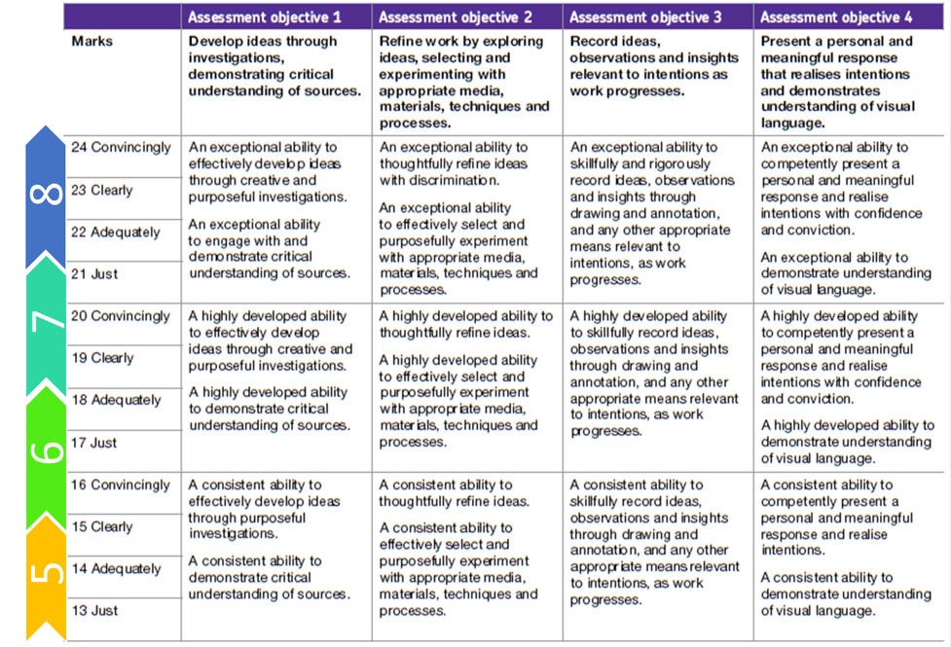
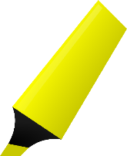
LO: To understand the fact there are 3 parts to your course, and that each part is marked in 4 sections

Slide 3
COMPONENT ONE:
Each student must select and present a portfolio representative of their course of study. The portfolio must include both:
1 A selection of work resulting from activities such as trials and experiments; skills-based workshops; mini and/or foundation projects; responses to gallery, museum or site visits; work placements; independent study. DECORATIVE TECHNIQUES EXPERIMENTS
2 A sustained project developed in response to a subject, theme, task or brief evidencing the journey from initial engagement with an idea(s) to the realisation of intentions. COURSEWORK STYLE PIECE ON LAMPSHADE PROJECT / CULTURE / CHILDS EDUCATION / RECYCLED / ALL THINGS BRITISH ETC…

Slide 4
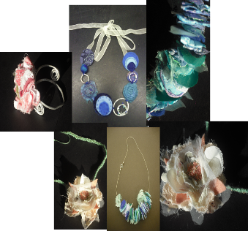
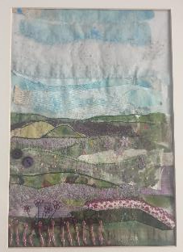
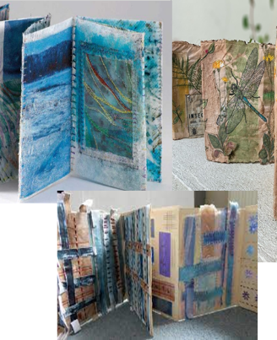
MINI PROJECT EXPLAINED

Slide 5
Use the guidance sheet to help you see what you will do in this project with an explanation

Slide 7
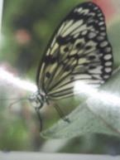
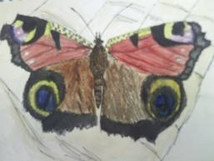
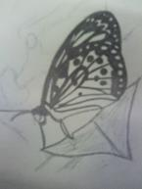
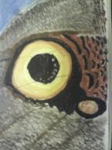
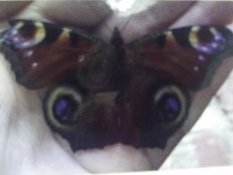
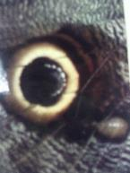
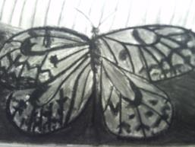
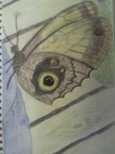
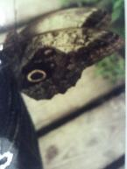
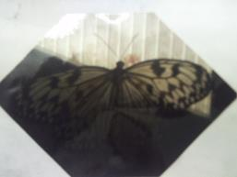
I picked BUTTERFLIES

Slide 9
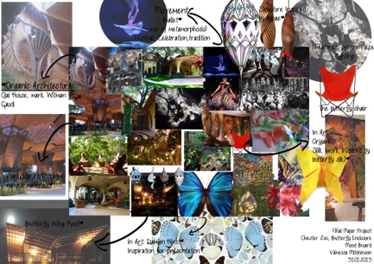

Slide 10
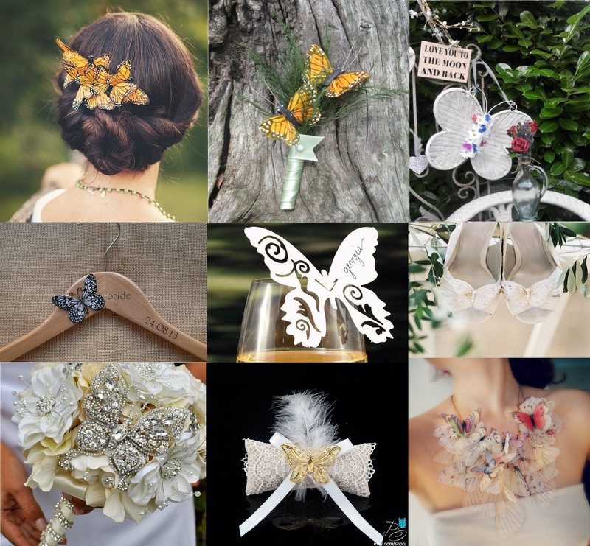

Slide 11
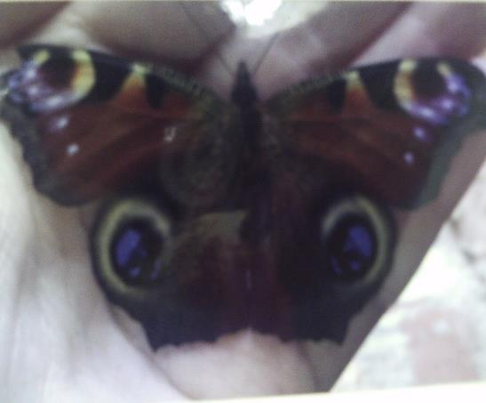
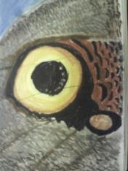
My favourite part of the butterflies were the eyes on the wings so this will inspire my jewellery design

Slide 12
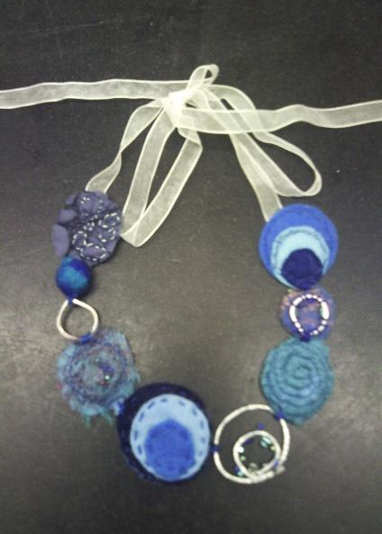
DESIGNING

Slide 13
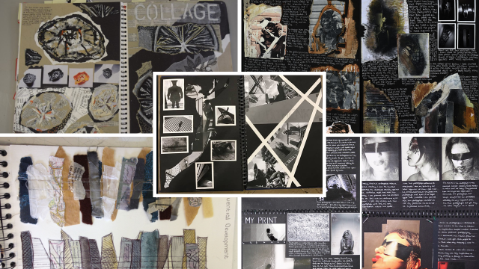
LO: Create a title page on ‘DECORATIVE TECHNIQUES’
Be creative with your presentation

Slide 14
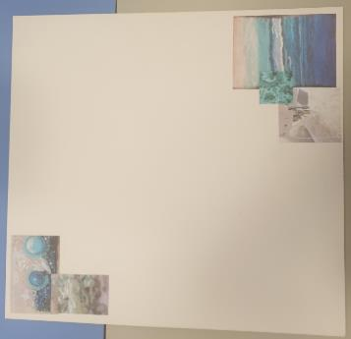
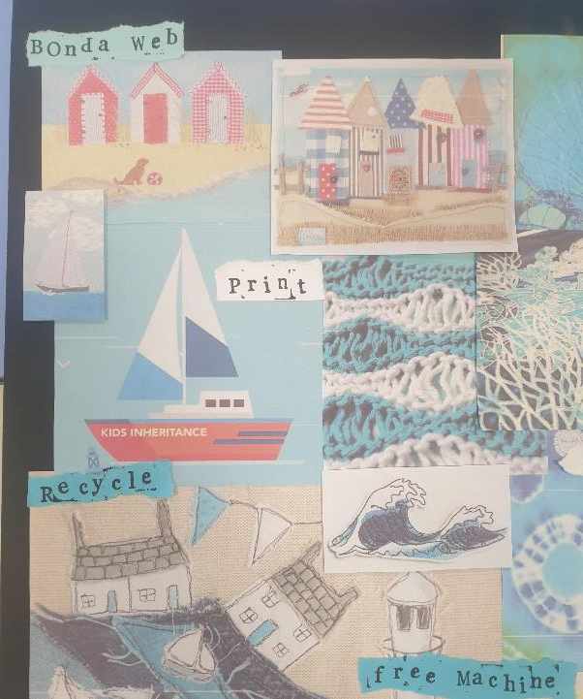
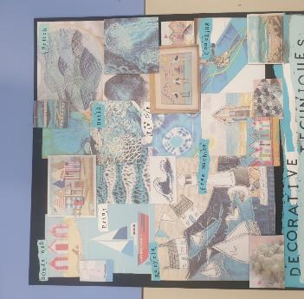
LO: Create a moodboard of DECORATIVE TECHNIQUES
On tabs/ the back or front
Talk about which of the techniques you really like
Explain how you would like to experiment with them and you could start to think about your theme
Never write ‘because it is nice’… be specific
Be creative with your presentation
Add keywords naming the techniques (remember the wall display near the door has lots of the techniques names to help you)

Slide 15
LO: Create a title page on YOUR CHOSEN THEME
Be creative with your presentation

Slide 16
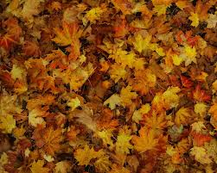
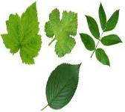
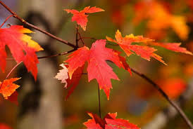
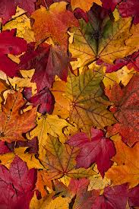
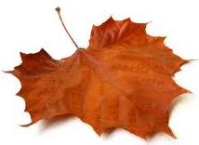
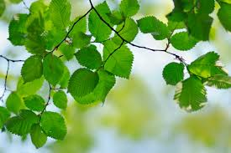
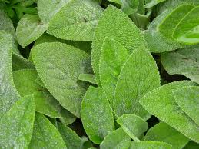
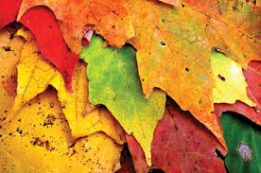
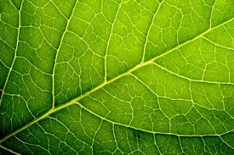
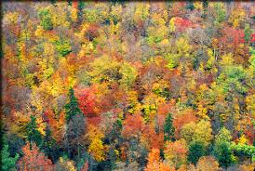
PICK A THEME:
EXAMPLE MOODBOARD
Say what made you pick that theme, and how it will inspire you
LO Over the next 6 weeks: To learn about a wide range of experiments and produce at RANGE of THEMED SAMPLES presenting them in a creative way.
Notes:
Possible themes: Sea side, Animals, Seasons, Fruit, Insects, Abstract pattern, Cultures, Leaves, History, Architecture, their family, growing up, child hood, farming etc….

Slide 17
PICK A THEME:
EXAMPLE MOODBOARD
Say what made you pick that theme, and how it will inspire you
LO Over the next 12 weeks: To learn about Textiles decorative techniques and produce at RANGE of THEMED SAMPLES in your sketch book or concertina book, presenting them in a creative way.

Slide 18
Mood-board:

Slide 20
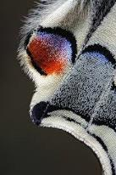
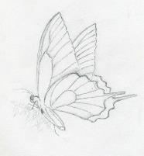
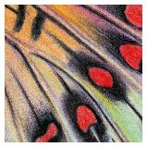
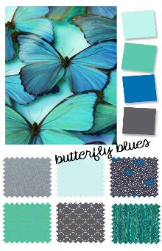
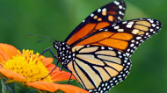
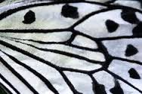
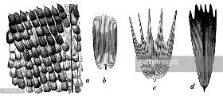
Once you have completed the mood board you need to draw from it.
You should pick out any shapes, patterns and colours that you like.
Again say:
How you created it (using what media)
Why you picked that image to work from
What has gone well and how you could improve it
LO Over the next 6 weeks: To learn about a wide range of decorative techniques and produce at RANGE of samples in a creative way.

Slide 21
I picked BUTTERFLIES

Slide 22
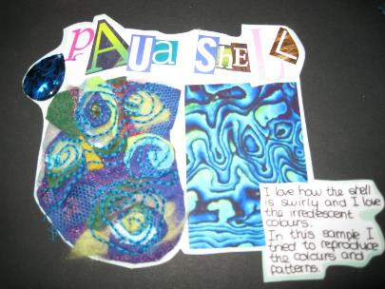
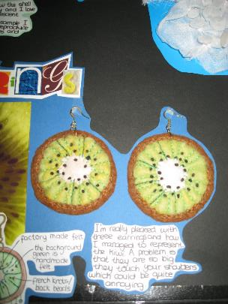
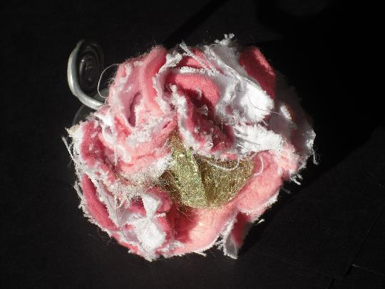
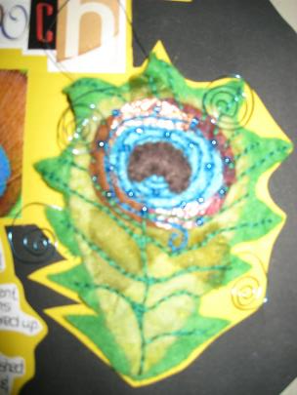
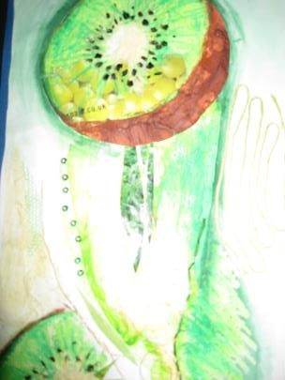
LO: create a sample of each of the different decorative techniques…relating to your theme

Slide 24
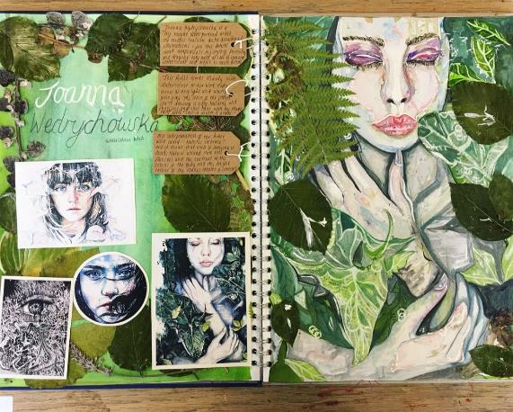
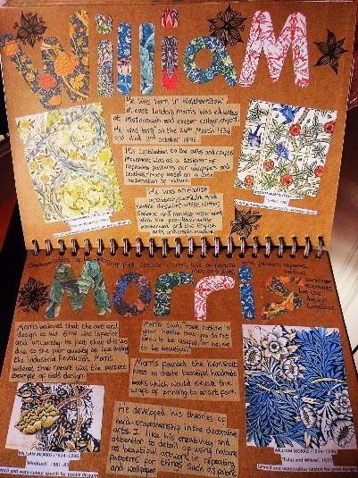
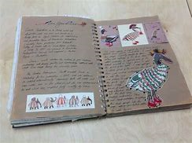
7+: Research a TEXTILES DESIGNER / ARTIST / PRINT DESIGNER that inspires you and links to your theme Create a fact page about them and then have a go at recreating their work in your own style

Slide 25
DECORATIVE TECHNIQUES – we will do these in school!!
A wide range of techniques carried out
Clearly developed – so if something went wrong on your first sample stick it in tell me why is it wrong and then how you improve it with the new and improved sample too
Where will you use it on your final design , or if you don’t like it tell me why e.g. I will not use it as it will not withstand repeated use or it is not very easy to sew through etc.…
DO NOT THROW ANYTHING AWAY

Slide 26
Grade 4 Creating samples linked to artist
Create a range of developed samples inspired by your artist/designer/ theme. Remember it should go through a set of improvement stages.
Grade 7+ Further develop samples linked to artist with your own twist
Grade 6+ Develop samples linked to artist with your own twist

Slide 27
Look at your to do list …
What colour DOT did you get?

Slide 28
My favourite part of the butterflies were the eyes on the wings so this will inspire my jewellery design

Slide 29
DESIGNING

