Slide 1
Human Centred Design
Afternoon All
Lesson starting shortly
Just waiting for everyone to join us

Slide 2
Making a product easier to use
Can you redesign a product to make it easier to use for a specific person?

Slide 3
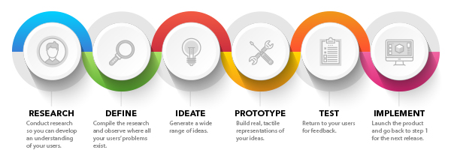
Human Centred Design
What is Human Centred Design (HCD)?

Slide 4
Research – 10 minutes

Slide 5
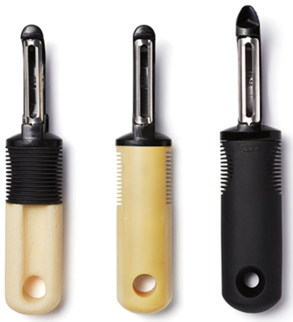
Today’s lesson
You’re going to find out about a couple who loved to cook but found it difficult to use everyday kitchen utensils because of their arthritis.
Sam Farber developed a more comfortable handle for a traditional metal-handled potato peeler. It set the trend for a series of new kitchen products that set a new standard for utensil design.
A new brand was developed called OXO and they became world-famous for ergonomically designed utensils that are easy to use for everyone.

Slide 6
Starter
DISCUSS: What does ‘ergonomics’ mean? Take 2 minutes to look up the meaning of the word and be ready to write your definition into the lesson chat.
ACTION: as a group, discuss and create a class definition for the technical term ‘ergonomics’.

Slide 7
Product observation
Watch the video clip below to get an idea of OXO product range.
Link here: https://youtu.be/7DZ9VD8cjTU
Notes:
Video is about 7 minutes long. Might be a better video out there that is shorter. A lot of the utensils at the end do the same thing (e.g. spatula/fish slice)

Slide 8
Discussion
QUESTIONS:
How do the OXO kitchen gadgets differ from more traditional products?
What are the most important design features of the OXO range?
Notes:
You may want to skip some of the video – it’s quite repetitive, especially near the end.
Feel free to add your own targeted questions.

Slide 9
Task Extension
Using your new TinkerCAD skills have a go at CADing your chosen product
Notes:
Measuring jug links
https://www.oxouk.com/products/preparing/pancake-day/1-cup-angled-measuring-cup
https://www.amazon.co.uk/dp/B0033X4DJ0/ref=asc_df_B0033X4DJ01609326000000/?ascsubtag=s1609280481655ga2ba52981&tag=52981_iceleads-21&creative=22374&creativeASIN=B0033X4DJ0&linkCode=df0
Drinking cups
https://www.oxouk.com/products/baby-toddler/drinking
https://static.independent.co.uk/s3fs-public/thumbnails/image/2020/03/19/17/babycup.jpg?width=640
Potato masher
https://images-na.ssl-images-amazon.com/images/I/710TlMej61L._AC_SL1500_.jpg
https://www.oxouk.com/catalogsearch/result/?q=potato+masher

Slide 10
Tasks
Choose one of the tasks below. It will last for the rest of the lesson. Make sure you keep your finished work saved in a safe place so you can share it with your teacher when we return to school.
ONE
Look at OXO’s angles measuring jug here. You can also check out some more product details here on Amazon’s website.
Using PowerPoint, create a promotional presentation for Amazon that highlights the unique features of OXO’s jug and how these features will make the jug suitable for a wide range of end users.
TWO
Compare OXO’s range of toddler drinking cups (click here) with a traditional child’s drinking cup (click here). Create a presentation that analyses the similarities and differences between OXO’s cup and the traditional cup. Explore the positives, the negatives and the interesting features of each range. Which do you think is best for a toddler? Explain why using images, notes, bullet points and annotations.
THREE
Analyse the potato masher (click here). On paper, explore how you could improve this design to make it suitable for an elderly person. Why might an older person struggle to use this particular utensil? What features could you add? How does it need to change? Use sketches and annotations to explore your thoughts. Check out OXO’s designs if you need some inspiration…
Notes:
Measuring jug links
https://www.oxouk.com/products/preparing/pancake-day/1-cup-angled-measuring-cup
https://www.amazon.co.uk/dp/B0033X4DJ0/ref=asc_df_B0033X4DJ01609326000000/?ascsubtag=s1609280481655ga2ba52981&tag=52981_iceleads-21&creative=22374&creativeASIN=B0033X4DJ0&linkCode=df0
Drinking cups
https://www.oxouk.com/products/baby-toddler/drinking
https://static.independent.co.uk/s3fs-public/thumbnails/image/2020/03/19/17/babycup.jpg?width=640
Potato masher
https://images-na.ssl-images-amazon.com/images/I/710TlMej61L._AC_SL1500_.jpg
https://www.oxouk.com/catalogsearch/result/?q=potato+masher

