Slide 1
WJEC Engineering – Controlled Assessment Checklist
All the work is required to pass your controlled assessment. PowerPoint templates for all sections can be found at common:\Technology\Engineering\WJEC
Research Section
Task | Explanation | Completed (Y/N)
Analysis of Design Task | Analyse the design task and highlight and explain areas you need to research
Existing Products | Analyse and evaluate TWO existing products using the ACCESSFM grid. REMEMBER you have to explain why you think something eg ‘This product is made from steel because…….’
Relevant Sizes | Research sizes of objects (iPods, iPads,etc.) and explain why the research is important and how it will effect you design ideas.
Ergonomics and Anthropometrics | Research how you will need to use ergonomics and anthropometrics in designing successful products. A short paragraph for each explain what they are and then go into detail how they will effect your design ideas. Highlight key data.
Clamping and holding mechanisms | Research and analyse different clamping and holding mechanisms. Take a picture of them, explain how they work and how effective they are. Also discuss what material they are made from.
Specification | A Design specification describes in simple specific sentences what you intend your product to be like and what you hope to achieve (bullet points) . Your specifications can be developed under the following headings: Function, Performance , Area of use, User Requirements, Aesthetics, Ergonomics & Anthropometrics , Materials , Manufacturing, Cost, Safety, Environmental issue, Durability. There is another PowerPoint to help you with this

Slide 2
Unit 1 Engineering Design

Slide 3
Designing: Analysis
Name:
Derry Accessories Ltd. is looking to design a new ‘generic’ type of mobile phone charger. The company is prepared to consider any options for charging mobile phones but is eager to ensure that all phone functions are accessible when charging. Derry Accessories Ltd. views the development of this new model as an opportunity to promote the company and wants to see the logo on all future products.
Your task is to design a new generic mobile phone charger.
TASKS
1. Identify the key features and functions required from the information provided. Use this information to develop a design specification.
2. Suggest three options to meet the design specification which are based on successful engineered products. Review the suitability of each and recommend the best option.
3. Using accepted standards and conventions, draw your preferred solution.
Areas I need to research from the design task | Explanation
Engineering @Hope Valley College

Slide 4
Analysis : Existing Product 2
Name:
ACCESS FM | Analysis Information
Aesthetics Describe the look of the product
Customer Who is the product aimed at? Is it suitable
Cost Is the price reasonable
Ergonomics Has the designer made the product easy and comfortable to use?
Safety How safe is the product to use?
Size Is the product in proportion and scale?
Function What does the product do? How well does it carry out the function?
Materials What is the product made of and why have these materials been used?
Product Pictures:
Engineering @Hope Valley College

Slide 5
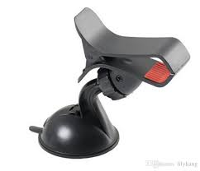
Designing: Analysis
Name:
ACCESS FM | Analysis Information
Aesthetics Describe the look of the product | This product looks very nice. You can tell how it works just by looking at it. It has a little bit of red on it were the phone is gripped. It has a nice plastic texture. It has smooth edges making it a very elegant design
Customer Who is the product aimed at? Is it suitable | This product will be aimed at people with cars but also just for home use as well so I imagine that it is aimed at all people
Cost Is the price reasonable | It has a cost of $3. I believe that this is reasonable because of its easy use and practical function
Ergonomics Has the designer made the product easy and comfortable to use? | It is fairly small at just 15cm tall and 5cm wide. This would fit nicely into your hand but easily adjustable with 2. the socket and ball locking system might be a little hard to access as the clip covers it slightly. The clip has been angled so that the clip is easier to open. This angle is important because it must stay east to use as the clip opens. The spring must be strong enough to hold your phone securely but easy to open with one hand.
Safety How safe is the product to use? | This seems to be very safe as it has a large suction cup so it is safe. It does have a spring loaded design which could be harmful if used in the wrong way or being careless. Over all, it looks very sturdy and will secure your phone from falling or the mount from falling in your car.
Size What does the product do? | This product will fit most phone sizes side ways and very few horizontally. This may be annoying if your are wanting maybe a satnav or your phone doesn’t work sideways. With small phones, it will not work as well because the hooks will cover part of the screen.
Function What does the product do? How well does it carry out the function? | The phone holder will carry out its function but it will probably be used for long journeys and minimum contact with the screen because of the awkward position and the little upturned plastic hooks, which are there to keep the phone in place, cover the screen a little.
Materials What is the product made of and why have these materials been used? | It is made of plastic that has been molded into the correct shape. There are a few screws to keep it all together. And there is a silicon suction cup and pads to protect the phone from scratches.
Product Pictures:
GCSE Engineering @Hope Valley College

Slide 6
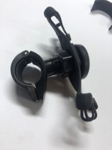
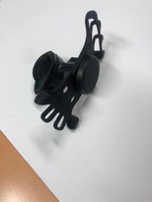
Designing: Analysis
Name:
ACCESS FM | Analysis Information
Aesthetics Describe the look of the product | This product looks a little messy as the elastic plastic is bending. It has no logo on it. The colour is black. This is nice because it is not gender specific
Customer Who is the product aimed at? Is it suitable | This product is aimed at people using bikes and that want a screen to show information like a sat nav. So this suggest people that might cycle to work.
Cost Is the price reasonable | This product is £7.99 . I believe this is reasonable for the quality of the product as this is much cheaper than bike satnavs
Ergonomics Has the designer made the product easy and comfortable to use? | It has an elastic mechanism that has to be operated with two hands.. It is easy to take out with one hand because of the friendly size and the stretchy rubber can be taken out with one hand. However, the locking ball and socket might be a little hard to access when a phone is on. The bolt that goes through to clamp may be hard to use as the grip is not very good on it.
Safety How safe is the product to use? | I believe it is quiet safe because the elastic can secure your phone very well. It will not get in your way when you are cycling as it goes on your handle bars. If you ride on a more bumpy track, I would not recommended this as it is only made of plastic.
Size What does the product do? | This holder would hold larger phones better as the elastic would be more secure. However, with smaller phones, it could be dangerous as the elastic wont be in tension giving the phone a higher chance of falling out.
Function What does the product do? How well does it carry out the function? | This is used to hold a phone when on a bicycle. It leaves the screen free for notifications or for a satnav. The angle is controlled by a locking ball and socket mechanism. This is good as it can change angle but then be secured without wobbling around. It then clamps onto the handle bar of a bike. It has a rubber lining so it does not slip and scratch the bars.
Materials What is the product made of and why have these materials been used? | It has durable alloy bolts to ensure sturdy fitting. The plastic, which is most likely to be polypropylene because it can be easily molded, is strong and light so that makes it practical to be on handle bars. This means that it does not make turning uneven when riding
Product Pictures:
GCSE Engineering @Hope Valley College

Slide 7
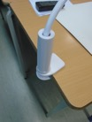
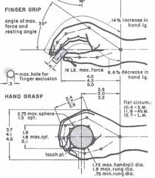
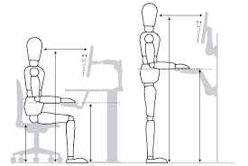
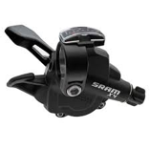
Analysis:
Name:
Ergonomics and Anthropometrics
The study of the human form is called anthropometrics. This is the measurements and proportions of the body. This is applied to different products to make them work better or more efficiently.
This is an anthropometric analyse of the hand. These measurements will be taken by companies for them to design products that fit. This could include glove manufactures
Ergonomics of a product is how it is designed to fit to the body of the user. This is the size, shape, weight, fit etc. Ergonomics come from the anthropometrics
For example, the shape of a button may be altered to suit the shape of the pad of a finger. However, if it is operated by a thumb then the button may be longer.
In this image, the desk is designed ergonomically to the user from the anthropometrics data.
Engineering @Hope Valley College

Slide 8
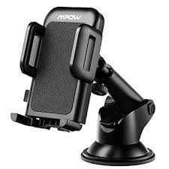
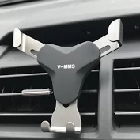
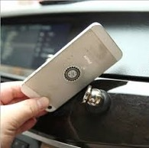
Analysis:
Name:
Clamping and holding mechanisms
This gripping mechanism consists of 3 areas of contact, two are controlled by a rack and pinion system that is pressed together with some force but it will not spring back as the rack and pinion allows it the lock in position. It is then released using a lever that depresses allowing the side clamps the release. This clamping system is very safe as it can be easily operated with one hand
The gripping mechanism here is controlled by gravity. As the bottom grip is pushed down, the side clamps move in until it touches the phone, this is very sturdy as the vertical force of the weight of the phone is transferred to a horizontal force
This magnet system has a magnet stuck on the back of the phone and a magnet on the joint. It if there is a big jolt then the magnet could come off causing the phone to fall. This gripping mechanism is permanently on your phone which some users may find annoying.
Engineering @Hope Valley College

Slide 9
Analysis : Other relevant research
Name: The Forces
This CAM system makes a vacuum that holds the mount onto the surface. As the CAM arm is moved up the offset circular motion changes to a linear motion and it lifts the middle of the suction cup up causing a vacuum. The position of CAM system is important as it must cause a large enough vacuum to support the older well but still easy to operate.
When pushed down, the clip rotates around the fulcrum. This is rotatory motion. The spring is push under tension but it has been designed so that is does not snap or is too weak. The rotatory tension of the spring is transferred to the a larger pivot through the clamp.
The locking system is rotatory motion that clamps the ball and socket system. The torque applied must be enough to lock it securely but not too much that is comes undone.
The friction between the arm and the base must have a torque that is strong enough to hold the holder and phone upright but loose enough to alter with one hand. This would be good if it had a way of tightening this or loosening as over time, the force will change.
Engineering @Hope Valley College

Slide 10
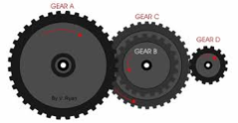
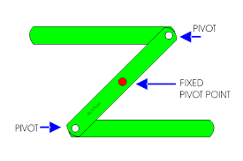
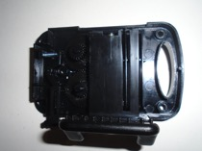
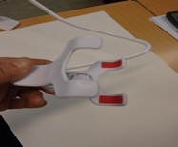
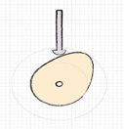
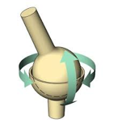
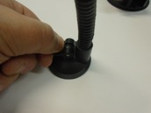
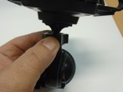
Analysis : Other relevant research
Name: Mechanical systems
Linkages and Levers
Levers increase the force applied to an object through a circular motion. The longer the lever, the more force applied. Linkages change the direction of motion. In this phone holder, the lever opens up the clamp on the other side of the moment. If it was longer. It would be easier to open but it would not be practical for the user.
Gears and Gears Trains
This system is when the teeth in different gears interlock which causes the different gears to turn. The different size gears when interlocked could be to alter the revolutions, torque or position of motion. In this phone holder, the gears are used to change linear motion to rotatory motion. It also changes the speed that the gears move.
CAMS – Creating vacuums
A cam is an offset shape that is on an axis that turns round. Usually being an oval, as it is turned round, it transfers the circular motion to a linear motion . In this phone holder, as the CAM is turned round, it lifts up a rod that pulls up a rubber base that then creates a vacuum on the surface
Ball and socket
The ball and socket is a joint that allows two objects to work independently to each other over a wide range of angles. A lockable ball and socket, like in this holder, is made by having a nut that screws down on ot he ball and socket. Small slits in the thread close as the nut is screwed. This locks the ball in place
Engineering @Hope Valley College

Slide 11
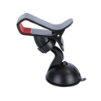
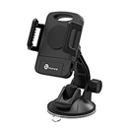
Analysis : Other relevant research
Name:
I am now going to analyse 2 different phone holders with a wide range of phone sizes
Phone name | Dimensions (width x height) mm | Phone holder
Samsung S8 | 68 x 149 | Both
Samsung S8+ | 73 x 160 | Both
Samsung Note 8 | 74.5 x 162.5 | Both
LG G6 | 72 x 149 | Both
OnePlus 3T | 74 x 153 | Both
Pixel | 70 x 144 | Both
Pixel XL | 76 x 155 | Both
IPhone 7 | 67 x 138 | Both
IPhone 7+ | 78 x 158 | Both
IPhone XS Max | 77 x 158 | Both
Zulky phone cradle
Teotronics phone mount
In conclusion, we can see that these phone holders have been designed very well as they fit a wide range of phone sizes
Engineering @Hope Valley College

Slide 12
Designing: Specification
Name:
A Design specification describes in simple specific sentences what you intend your product to be like and what you hope to achieve. Your specifications can be developed under the following headings:
Function – my product is meant to hold securely a range of different phone sizes. It will be supported by a strong clamp that secures on to the car. This could either be on to the air vent or the windscreen.
Performance – It will do this with a sprung loaded system that clamps the phone. There will most likely be 2 or 3 points of contact. It will be made of mostly metal as this is much stronger that plastic and I will design the points of contacts so that they hold the phone securely. This could include them having rubber inserts to have more friction on the phone but protect the phone from damage.
Area of use – I would design my phone holder to be used in a car. Later, I will decide weather I would like it to clamp on the air vent or the windscreen
User Requirements – I need to consider the size of the holder so that it is easily altered with one hand. Also. I need the holder to be able to change angle so that it can be changed angle to suit the drivers needs. I would like it to fit a wide range of phone sizes so that it will be successful.
Aesthetics – I would like my phone holder to be gender neutral so that it appeals to all users. This would mean colours like black or white. Also, I would like it to look smooth and professional. This would be done by using materials that are strong and that look good like aluminium or acrylic.
Ergonomics & Anthropometrics –my product will be designed so that it is comfortable to use and it can be operated with one hand. I will use the anthropometric data of the hand to work out how I can design my product so that it is the smallest size that can still fit the large phone and small hands. I will use different textures on the surfaces of the product so that it has good ergonomics to improve efficiency and ease of use.
Engineering @Hope Valley College

Slide 13
Designing: Specification
Name:
A Design specification describes in simple specific sentences what you intend your product to be like and what you hope to achieve. Your specifications can be developed under the following headings:
Materials – I need to use materials that are durable enough so hold a phone securely and withstand the vibrations of the vehicle. I also need to consider the weight and price of the material because this will allow it to be easy to move around or keep the price low so that it can be mass produced.
Manufacturing – as I am designing this product, I would be making prototypes so I will use fairly simple methods of making. This is like 3D printing and using CAD software.
Cost – I will make sure this is a strong durable product. This may increase the price but I would like to make sure it last a long time so the buyer will not need another one. I am going to try to design and make it for under £20 so that It is affordable but very worth the money.
Safety – I need to consider the safety factors of the product as it will be used within a car that will cause vibrations that the phone holder must withstand. I would like the holder to be minimalist and small to prevent it to block or distract the driver’s view and I want it to hold the phone in a way that it will have to lowest chance of falling out. I will holder with no sharp or dangerous exposed parts. This is important as I need the holder to be safe to use for all people.
Environmental issues – I will ensure that it is a long lasting product. This may compromise some materials not being recyclable but the metal will be recyclable and it will be easy to take apart as well. Also. I will try to use a small number of different parts so that small parts keep the effect to the environment low.
Durability – I will make sure my product withstands regular use by using metal and plastic that are put under tension in the correct ways. The metal with most likely be made of aluminium because this is a strong light metal. Also, so I do not go beyond the springs elastic limit, I will incorporate stoppers in the design so that the spring will stay strong in later use.
Engineering @Hope Valley College

Slide 14
Design Section
Task | Explanation | Completed (Y/N)
Design Ideas | Sketch 3 design ideas that meet the design brief and annotate them with how they work, materials they are made out of and how they could be made.
Against the Specification | Use your specifications points to evaluate each ideas. (spec headings; Function, Performance , Area of use, User Requirements, Aesthetics, Ergonomics & Anthropometrics , Materials , Manufacturing, Cost, Safety, Environmental issue, Durability) Mark each idea against the spec using 1-5 (5 being the best) and summarise your scores.
PowerPoint templates for all sections can be found at common:\Technology\Engineering\WJEC

Slide 15
Designing: Initial Idea 1
Engineering @Hope Valley College

Slide 16
Designing: Initial Idea 2
Engineering @Hope Valley College

Slide 17
Designing: Initial Idea 3
Engineering @Hope Valley College

Slide 18
Designing: Evaluating Initial ideas
Name:
Spec Criteria | Idea 1 | Idea 2 | Idea 3 | Summary
Function | 4 | 3 | 4 | I believe that idea 1 will work well because it is fairly small and it can hold phones that are much bigger than the holder itself. It also has 4 springs so this will ensure that it is strong. They are compression springs which are safer than tensile springs. This is better because they will not break or go beyond their elastic limit. Idea 2 is good but not as good as I believe it will not with stand the vibrations or movement of the car. However it is easy to use for anyone as there are no complex parts and no parts get caught. Idea 3 will work well in a car and will withstand vibrations because of the gravity locking system. However, the amount of moving parts could possible make it more prone to breaking and less easy to fix.
Performance | 4 | 3 | 4
Area of use | 4 | 2 | 3 | Idea one is fairly small and discrete so it will work well in a car. It attaches on to an air vent so can be used in a large variety of vehicles . It can also be used in different air vents meaning it does not necessarily need to be for the driver. Idea 2 has a CAM mechanism so it will be used on the wind screen. The problem with this is that it could be in the drivers view when driving. Idea 3 is used on a glue base. This is fairly good because it can be placed anywhere however it can only be used in one place .
Aesthetics | 3 | 3 | 4 | Idea one is boxy but small so could be altered to fit some designs on. Idea 2 might look a little messy when in use. But it can have nice smooth rubber on to ensure it looks nice. Idea 3 has nice curves on so it will bland into the shape of the car. It can have nice rubber on and the brushed aluminium will look nice and professional.
Ergonomics & Anthropometrics | 5 | 2 | 4 | Idea 1 is small and can extend to a very large size so this is ergonomically good as it can be operated with one hand. Idea 2 is not as well designed because the back plate might not fit in all hand sizes and the clamps could be too small. Idea 3 is better as it is easily operable with one hand is very simple to take in and out.
Engineering @Hope Valley College

Slide 19
Designing: Evaluating Initial ideas
Name:
Spec Criteria | Idea 1 | Idea 2 | Idea 3 | Summary
Materials
Manufacturing
Cost
Environmental
Durability
Total: |  |  |  | Chosen idea:
Evaluation Scoring: 5= excellent, 4 = very good, 3 = good, 2 = average, 1= poor
Engineering @Hope Valley College

Slide 20
Design Development Section
Task | Explanation | Completed (Y/N)
Final Design | Draw your final design idea using 3rd angle orthographic projection using accepted standards and conventions
Auto Desk Inventor Drawings | All parts of your final design drawn in Inventor. Assemble parts to make final design. Develop 3rd Angle Orthographic drawings of each part
Evaluate Final design against Specification | Evaluate your final developed design against your specification explaining each point.
PowerPoint templates for all sections can be found at common:\Technology\Engineering\WJEC

Slide 21
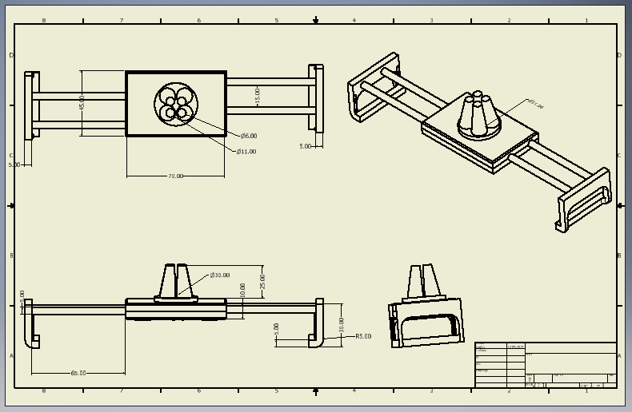
Development: 3rd Angle Orthographic Projection
Name:
Engineering @Hope Valley College

Slide 22
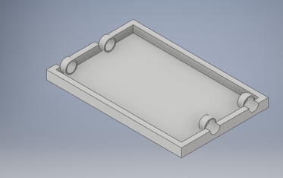
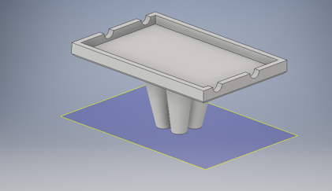
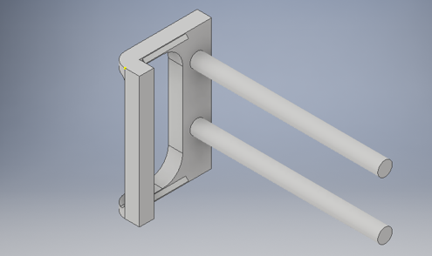
Development: CAD Parts
Name:
Engineering @Hope Valley College

Slide 23
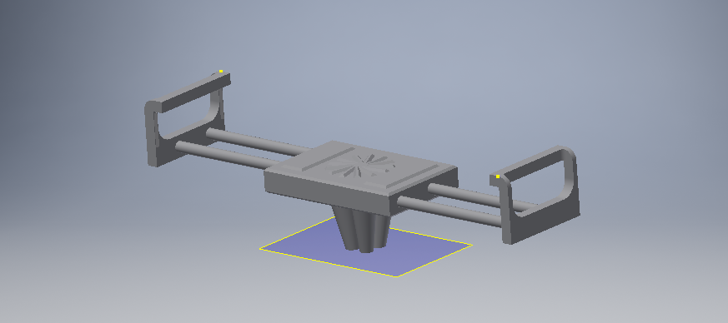
Development: CAD Assembly
Name:
Engineering @Hope Valley College

Slide 24
Development: Final Design Evaluation
Name:
Specification Point | Evaluation
Engineering @Hope Valley College

